Slide 1

A PROJECT ON
SOLAR POWERED GRID INTEGRATED EV CHARGING MODULE FOR SMART CITY
PRESENTED BY
C.SRIRAM (229L1A0417)
B.MANOJ (229L1A0407)
K.VAMSI (229L1A0424)
N.NARESH (229L1A0444)
Under the Guidance
OF
Mr.K.Siva prasad M.Tech,(ph.D) Dept of ECE
DEPT.OF. ELECTRONICS AND COMMUNICATION ENGINEERING
SIDDARTHA EDUCATIONAL ACADEMY GROUP OF INSTITUTIONS
(Approved by AICTE & Affiliated by JNTUA, Anantapur)
C . Gollapalli, Tirupati – 517505
2025 - 2026

Slide 2
CONTENTS
Introduction
Abstract
Existing System
Proposed System
Block diagram
Components
Explanation
Flow chart
Advantages
Applications

Slide 3
ABSTRACT
This project develops a solar-plus-grid EV charging module controlled by an Arduino Uno. PV panels supply renewable energy with grid backup for reliability. Sensors track voltage and current, while relays and a charge controller ensure safe charging. An LCD displays system status. The overall system offers an eco-friendly and scalable EV charging solution.

Slide 4
EXISTING SYSTEM
EV charging mainly dependent on grid supply.
Higher load on grid during peak hours.
Limited integration of renewable energy.
Lack of smart control and monitoring systems.

Slide 5
PROPOSED SYSTEM
Solar PV generates renewable energy.
Arduino monitors voltage, current, and battery level.
Smart switching between solar power and grid.
LCD provides charging and system status.
Charge controller regulates power flow.

Slide 6
INTRODUCTION
EV usage is increasing, creating demand for smart charging systems.
Solar-powered charging reduces reliance on the electrical grid.
Dual-energy source design increases system reliability.
Suitable for modern smart city infrastructure development.

Slide 7
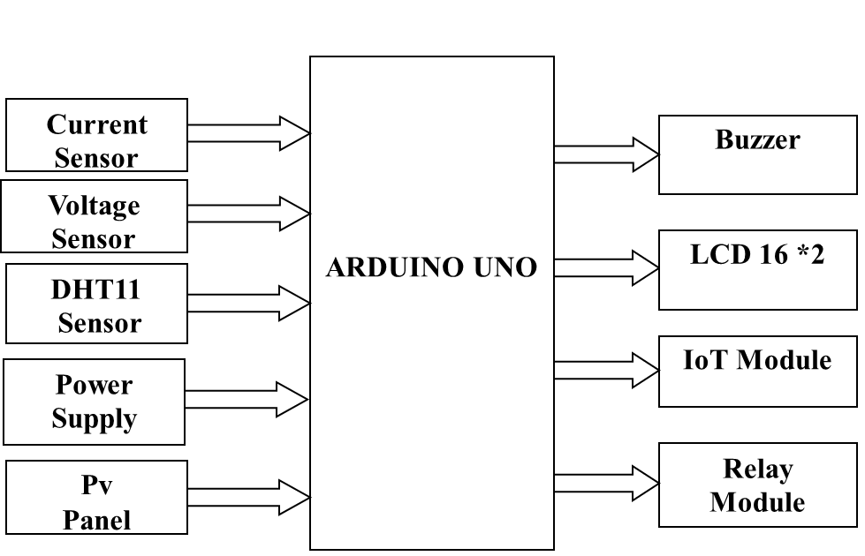
BLOCK DIAGRAM

Slide 8
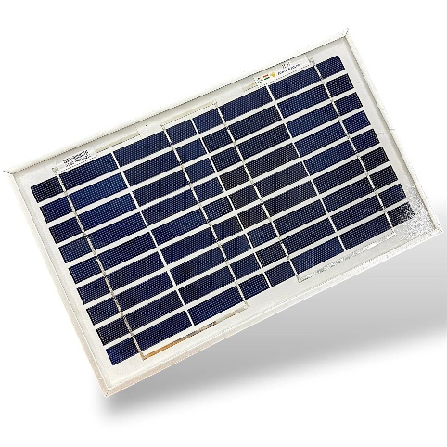
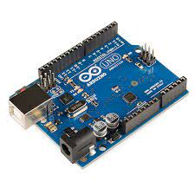
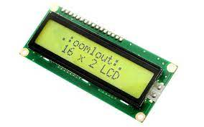
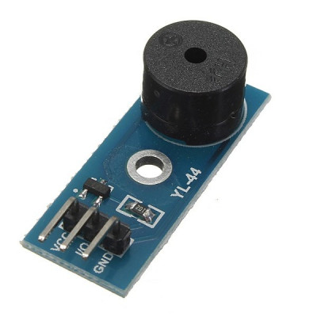
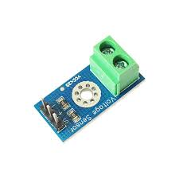
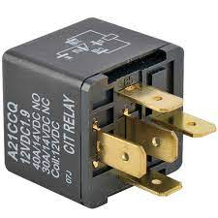
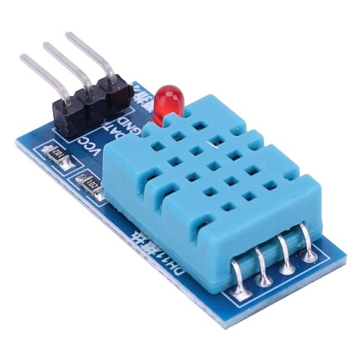
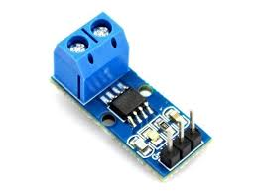
Components
ARDUINO UNO 16*2 LCD Solar panel
RELAY DHT11 Current sensor Voltage sensor
BUZZER

Slide 9
SPECIFICATIONS
Hardware requirements:
Arduino uno
16*2 LCD
Solar panel
Grid Power Supply
Buzzer
Relay
Grid Power Supply
Voltage & current Sensor
Software requirements:
Arduino IDE
Proteus

Slide 10
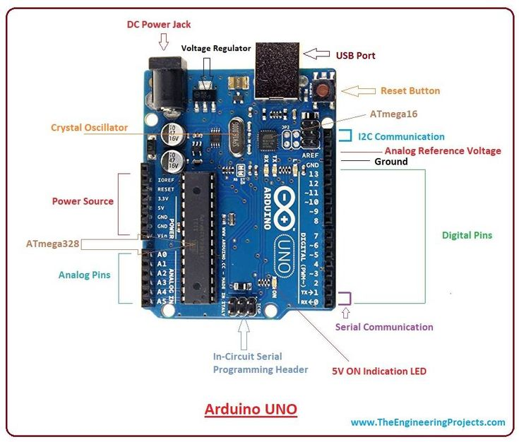
HARDWARE USED
Arduino is an open-source electronics platform used to build simple and complex electronic projects. It consists of a programmable microcontroller board and an easy-to-use software (Arduino IDE) to write and upload code. Arduino can read inputs from sensors (like temperature, voltage, or motion) and control outputs such as LEDs, relays, motors, and displays, making it ideal for beginners, students, and hobbyists.

Slide 11
Solar panel:
The solar panel converts sunlight into electrical energy and supplies renewable power for charging the electric vehicle, reducing dependence on conventional energy sources.
Buzzer:
It is an audio signaling device which may be electro-mechanical,mechanical or piezoelectric.
The buzzer starts ringing to provide an alarm indicating the presence of an unauthorized person.

Slide 12
Relay :
It is an electrically operated switch .
It consists of a set of input terminals for a single or multiple control signals and a set of operating contact
Solid
LCD :
The 16*2 LCD display is a very basic module commonly used in circuits .
Grid power supply:
The grid power supply provides backup electrical energy when solar power is insufficient, ensuring uninterrupted charging of the EV.

Slide 13
SOFTWARE USED :
Arduino IDE : Arduino IDE (Integrated Development Environment) is a software used to write, compile, and upload programs to Arduino boards like Arduino Uno. It supports Embedded C/C++ programming and provides tools like Serial Monitor for testing and debugging the code.
Proteus :Proteus is a simulation software used to design and test electronic circuits virtually before implementing them in hardware . It allows simulation of microcontrollers like Arduino along with sensors and other components, helping to detect errors before real-time implementation.

Slide 14
FLOW CHART:
Start
↓
Solar check
↓
Mode select
↓
Detect EV
↓
Charging ON
↓
Monitor-Display
↓
Charging done
↓
Stop

Slide 15
ADVANTAGES
Renewable, clean energy charging.
Reduces grid load and electricity cost.
Provides uninterrupted dual-mode charging.
Scalable and suitable for smart city infrastructure.

Slide 16
RESULTS
The system successfully charges an EV using solar power with automatic grid backup. It monitors voltage and current accurately and displays charging status. This project reduces grid dependency and ensures reliable charging.
Previous | Proposed
Only grid electricity | Solar energy with grid backup
No smart monitoring | Arduino based real time monitoring

Slide 17
THANK YOU

